Slide 1


Golan Regional Council Management Application​
By Guy Edri & Eldad Shneor.
Advisor: Dr. Naomi Unkelos Shpigel
Phase I
Project Code: 24-2-D-17
Project GitHub link

Slide 2
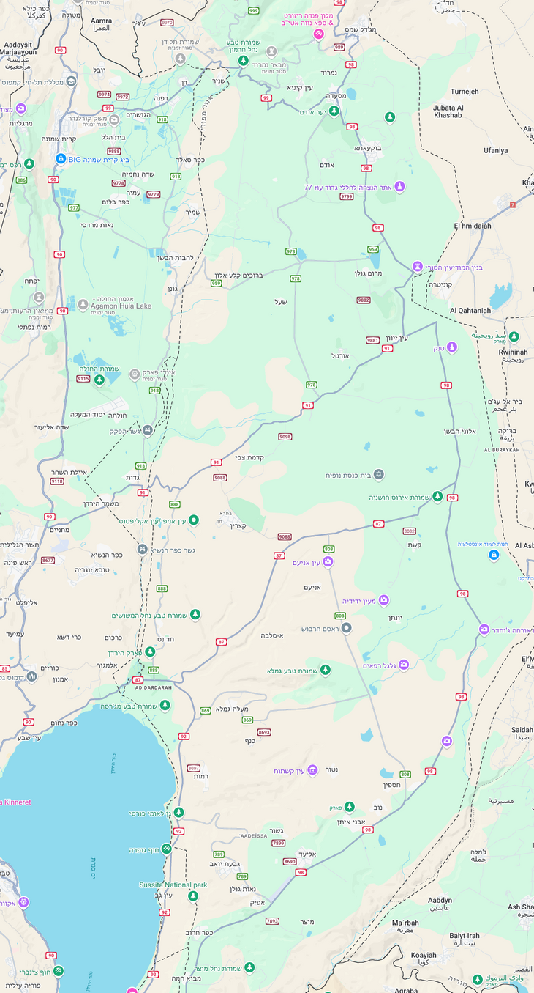
Introduction
Golan Regional council
Introduction
Golan Regional council
The Golan Regional Council has 33 villages under its jurisdiction.
The council, currently, has a serious problem with data management.
Each Village has its own file with an Excel file and a Word file, containing each village data.
2

Slide 3
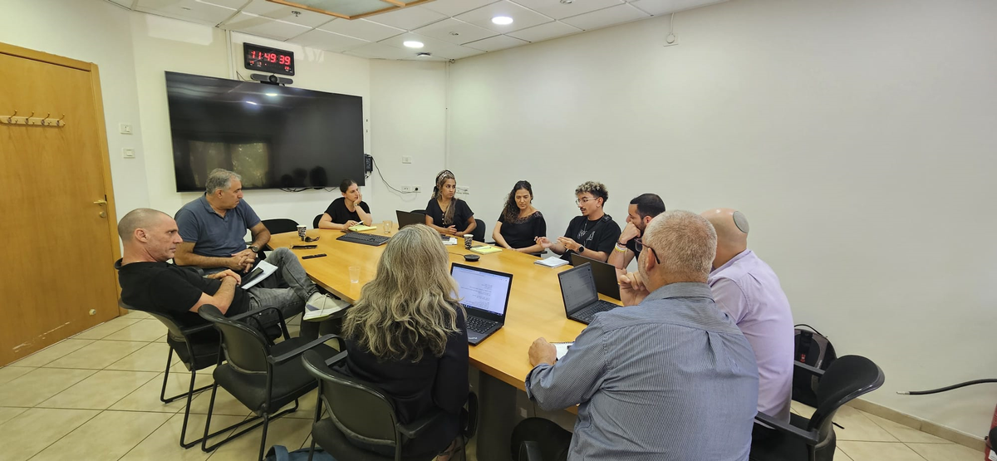
Motivation
“
Currently, comparative data is extremely difficult and time-consuming to gather across multiple villages. I am forced to go into each village case file manually and record the information. It is highly inefficient and wastes a lot of time.
”
Yaakov Se Lavan, Deputy chairman of the Golan Regional Council​
3

Slide 4




The Problem
Data Management Inefficiencies
Reports Obstacles
Collaboration Barriers
Separate Excel and Word files for each village
Difficult access and analysis of information
Complex process for cross-village comparisons
Time-consuming report generation
Lack of coordination among council employees
Impeded information flow
4

Slide 5
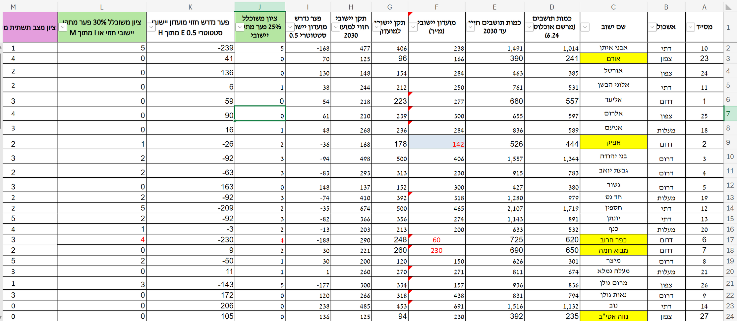
Current State of Work
5

Slide 6
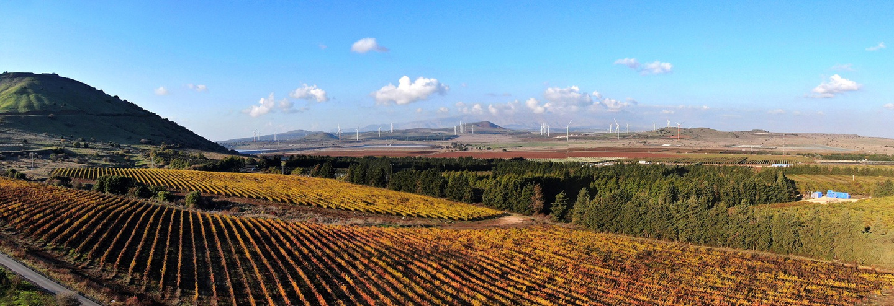







Our Solution & Objectieves
Web-Based Application
Centralized Data Management
Project Management Module
User-Friendly Interface
“Pitaron” Plan Integration
Scalable Solution
Back to Agenda Page
6
Notes:
Lets talk about our Solution and objectives. Our system will be a web based application created with the most modern technology's. we plan on creating a responsive accessible website that will allow all devices from desktop to mobile phones
We will create a Centrailzed data management which will be a critcal role in our system this will eliminate the use of excel and pdf files per village and will store all the data in one secure place.
With the integration of the pitaron plan which is a multi year infestractor devlopment for the golan heights.
Educational, Secuirty, Roads and more

Slide 7



Comparison to existing solutions
 | Our Application
User interface and experience
Data integration capabilites
Reporting and Analytics Tools
Scalablity and flexibility
Mobile Accessibility
7

Slide 8









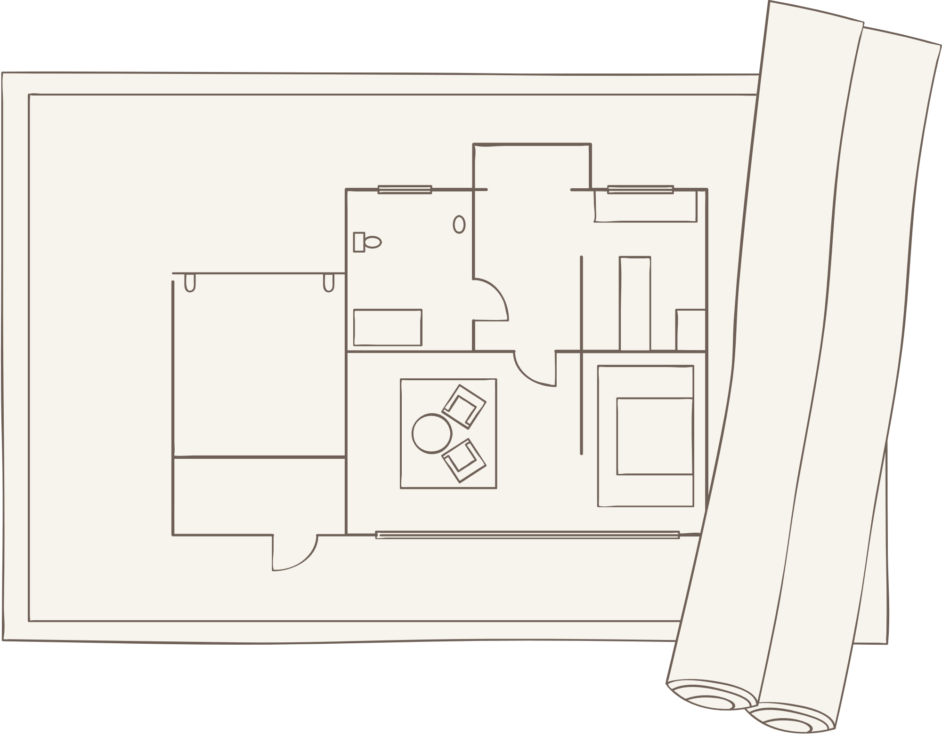

System Architecture
Client Side
Server Side
Database
Framework
Framework
Next.JS 1.4
React
TypeScript
&
JacaScript
Next.JS 1.4
Supabase
PostgreSQL
User Interface Components
Auth.js
Shadcn UI
Tailwind CSS
State Management
Zustand
8

Slide 9
Main Functional Requirements
The system will provide an overview of key analytics and statistics related to rural management.
The system will enable users to compare data across multiple villages.
The system will allow users to create, edit, and track projects.
The system will allow to generate reports based on selected criteria.
The system will store and manage data such as population, infrastructure and ongoing projects.
9
Notes:
Ok lets overview our functional requirements for the application
we will provide analytics and statistics, allowing users to compare data across multiple villages. Users will be able to create, edit, and track infrastructure projects, as well as generate reports based on specific criteria. Additionally, the system will store and manage critical data such as population, infrastructure, and ongoing projects.

Slide 10
Main Non-Functional Requirements
The system will support importing data from and exporting data to various formats (CSV, JSON, XML) for compatibility with other systems. - Compatibility
The application should be scalable to accommodate future growth in the number of users and data volume. - Scalability
The system should handle up to 500 concurrent users without performance degradation. - Scailablity
The application should be compatible with major web browsers (Chrome, Firefox, Safari, Edge). - Compatibility
10
Notes:
The system is designed to easily import and export data in formats like CSV, JSON, and XML, so it can work seamlessly with other tools. It’s built to be scalable, meaning it can grow as the number of users and data increases, and can handle up to 500 people using it at the same time without slowing down. Plus, it's fully compatible with all the major web browsers, like Chrome, Firefox, Safari, and Edge, ensuring smooth access for everyone.

Slide 11
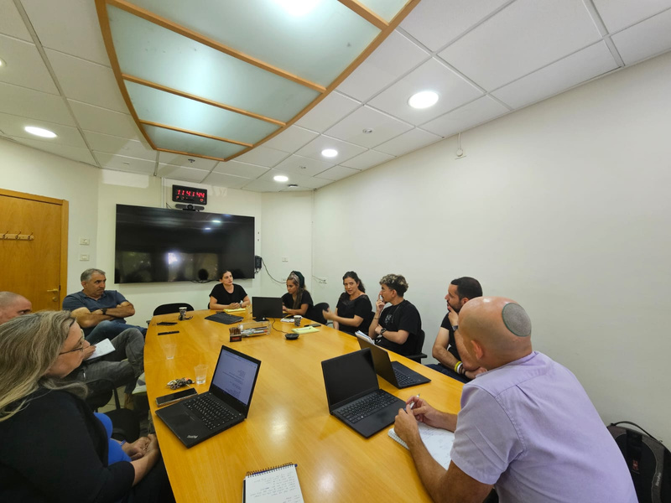
Timeline
15, July 2024
Sprint 1
8, August 2024
Sprint 2
Future
Development
First meeting with the Golan Council management
Missions:
Literature Review
Requirements
Use-Case
Technological Review
Early edition - Activity
Second meeting with Dovrat (designated liaison) for requirement validation.
Missions:
Moderated Activity
Updated Requirements
First Prototype.
Continuous Improvement Iterations
Knowledge Transfer and Documentation
Maintenance and Enhancements
Deployment and Rollout Strategy
11

Slide 12
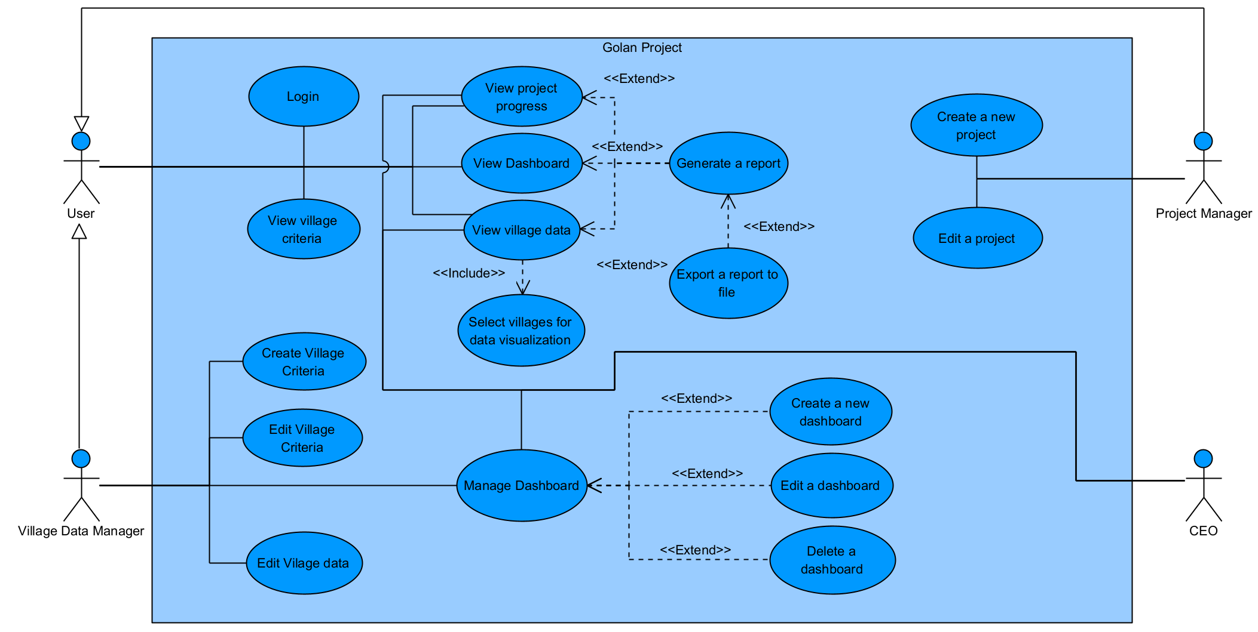
Use-Case Diagram
12

Slide 13
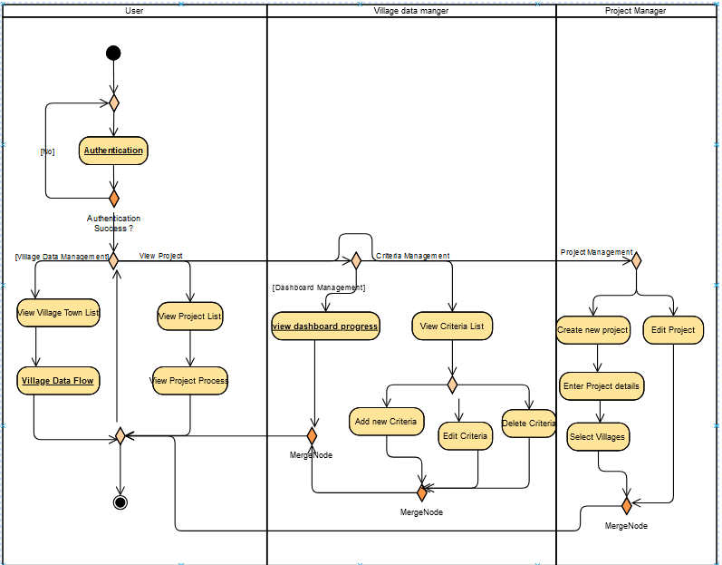
Activity Diagram
General flow
13

Slide 14
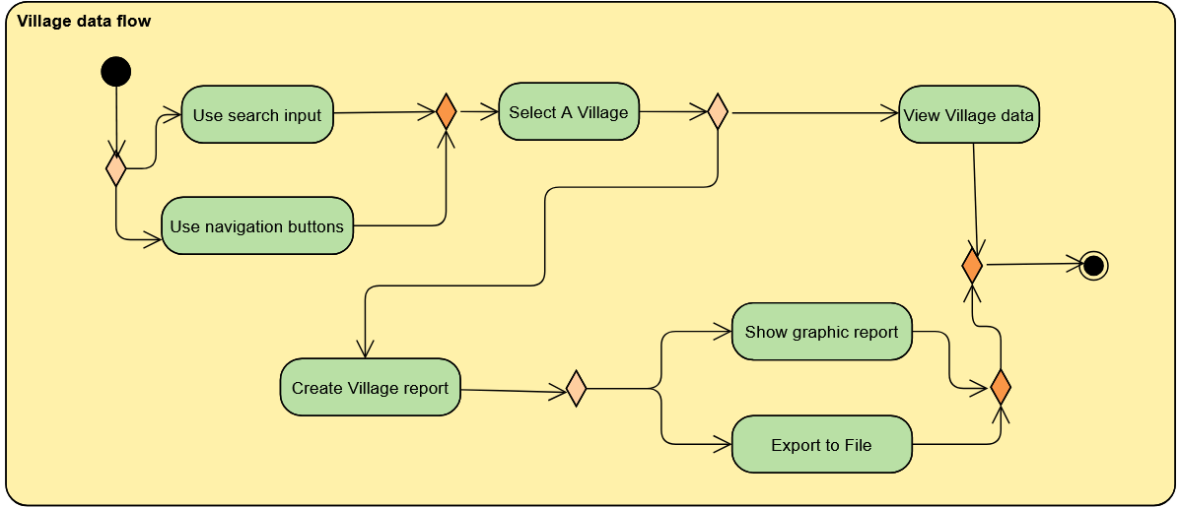
Activity Diagram
Village data flow
14

Slide 15
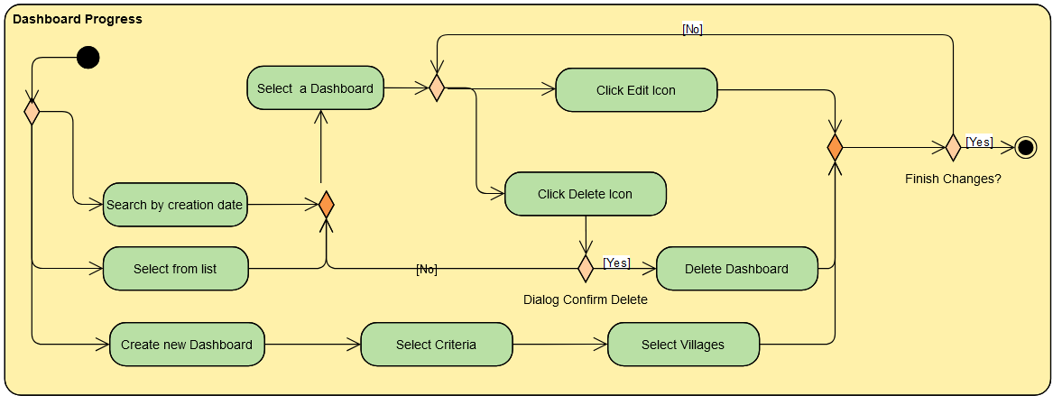
Activity Diagram
dashboard progress
15

Slide 16

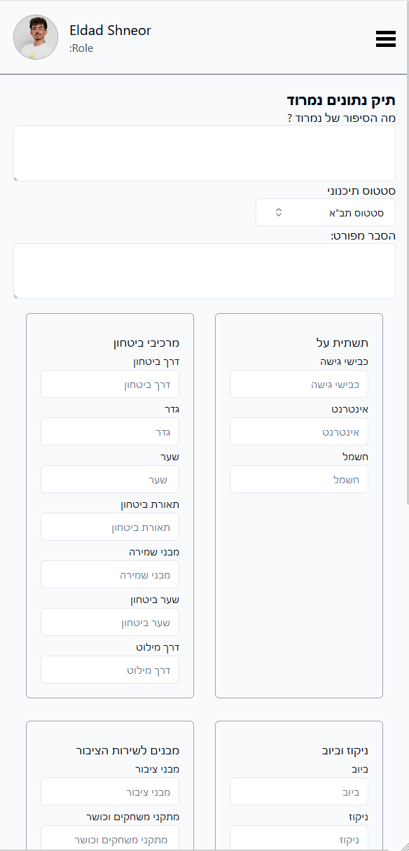
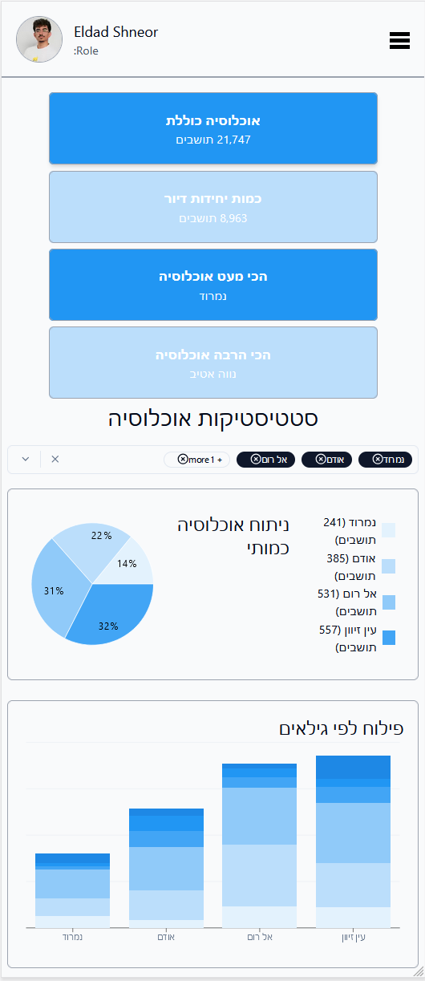

System Illustration
Mobile
16

Slide 17
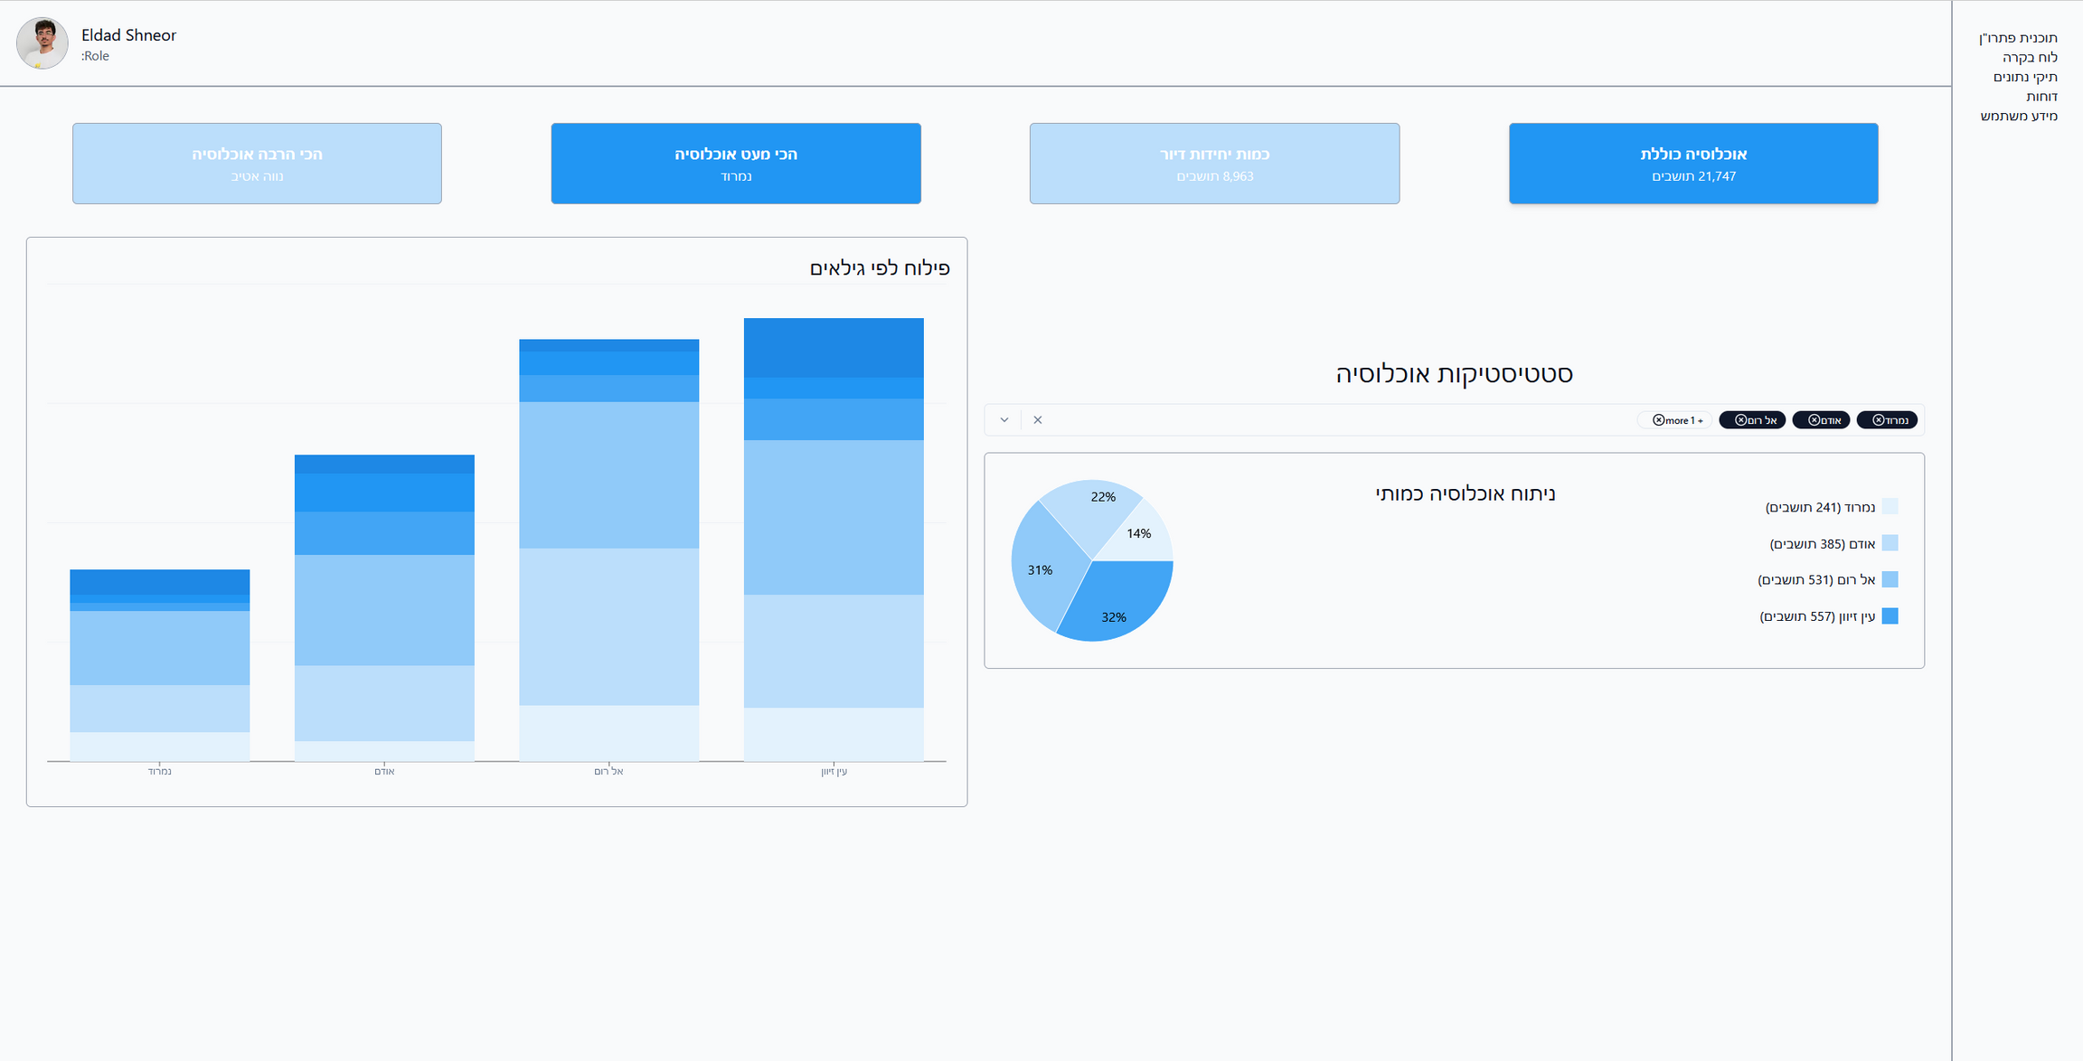
System Illustration
Comparative Dashboard
17

Slide 18
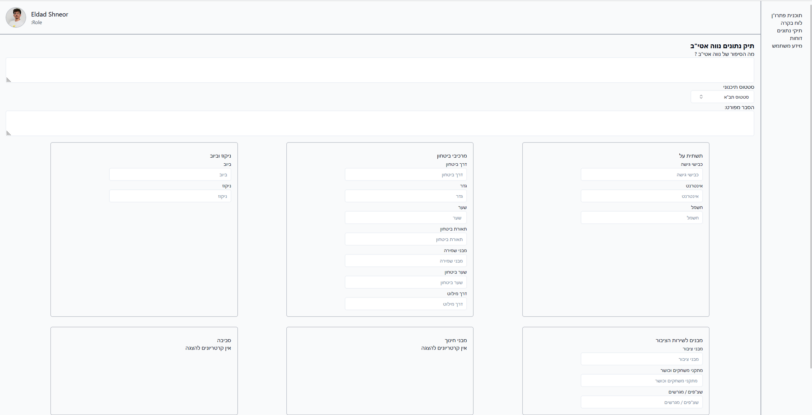
System Illustration
Village file
18

Slide 19


SUCCESS CRITERIA
Achieving 60% active users in the alpha phase for a week or more
Achieving an average score of 8 or above in an NPS survey
Achieving 70% or above of all new projects will be created and managed within the system
19
Notes:
An NPS score measures customer loyalty by looking at their likelihood of recommending a given business.

Slide 20
Testing plan
Test Types:
Functionality tests
Authentication tests
User Interface tests
Performance tests
Testing Areas:
User Login (Magic Code, Social Login)
Data visualization
Project management
Role-based access control
Testing Approach:
Unit tests using Jest
End to End tests using Cypress
20

Slide 21
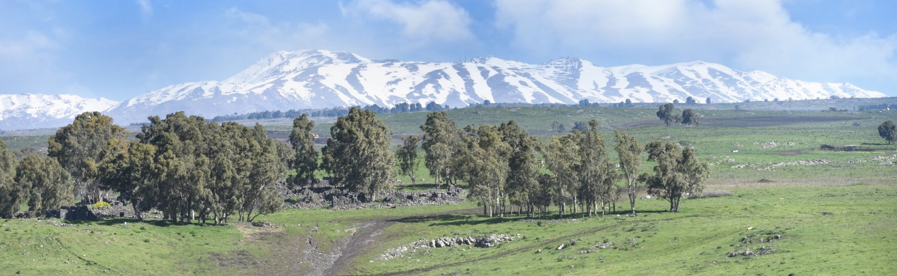
Thank you for listening!
Questions?
21

